Slide 1



CAR CONNECT
CAR RETAIL MANAGEMENT SYSTEM
TEAM 10
HARSHAVARDHAN BANDARU
RAJVI MANDAVIA
SAHIL PHALE
ISE-519

Slide 2




OBJECTIVE
SYSTEM FUNCTIONALITY
FUTURE ENHANCEMENTS
CAR CONNECT
OVERVIEW
SUMMARY
Discussing project scope and methodology with possible future upgrades

Slide 3

ABOUT
US
Providing a centralized platform for seamless car model acquisition.
OBJECTIVE
Streamlined interaction for inventory addition and modification.
Database querying for customer requirements.
Checks database to to match buyer requests with available car models.
CAR CONNECT

Slide 4
ABOUT
DATA
Dataset extracted from Kaggle
Data Components include:
(1) Historical supply chain data on car suppliers
(2) Customer feedback
(3) Available inventory amounts with suppliers for various car models.
CAR CONNECT

Slide 5


SYSTEM FUNCTIONALITY
CAR CONNECT
Data Cleaning
& Data Extraction
IDEF0 & IDEF1X
Forms, Queries
& Macros Creation
Visual representation of our functions, supplier and customer relationships, and information flow
MS Excel & MS Access
MS Access

Slide 6

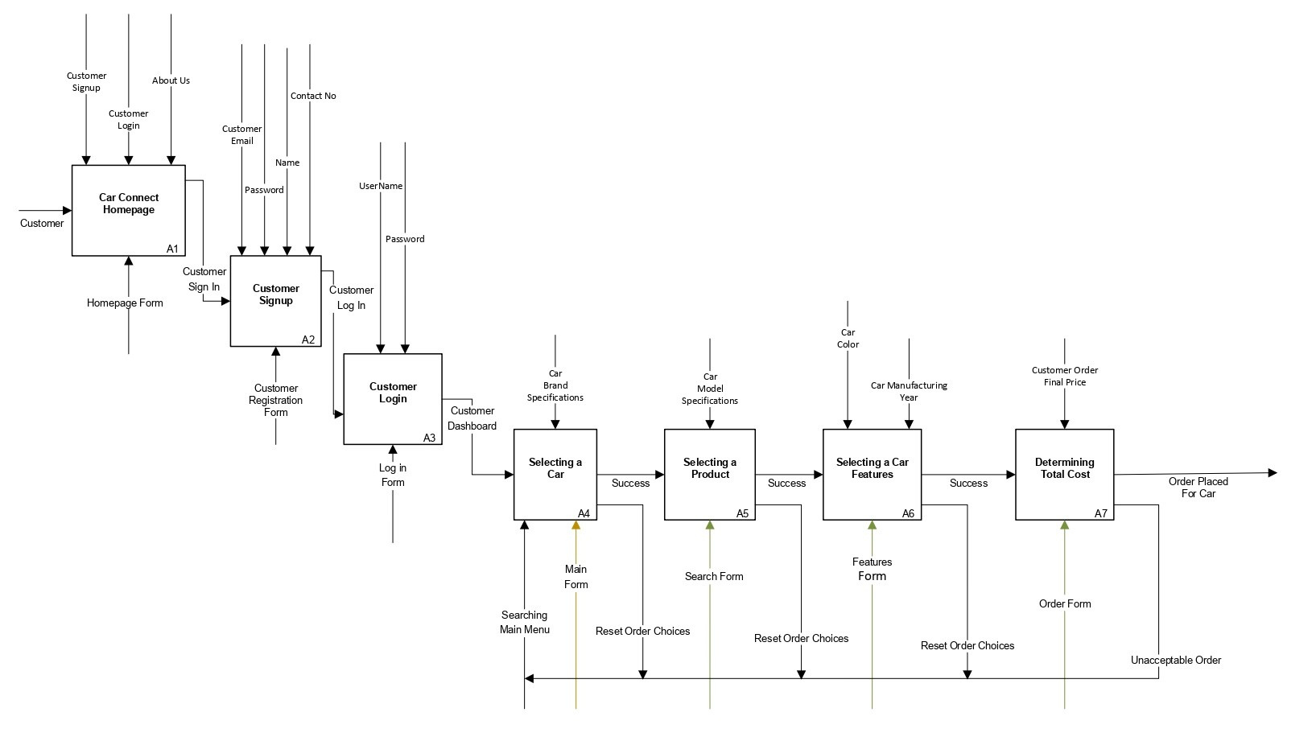
IDEF0 : CUSTOMER
CAR CONNECT

Slide 7
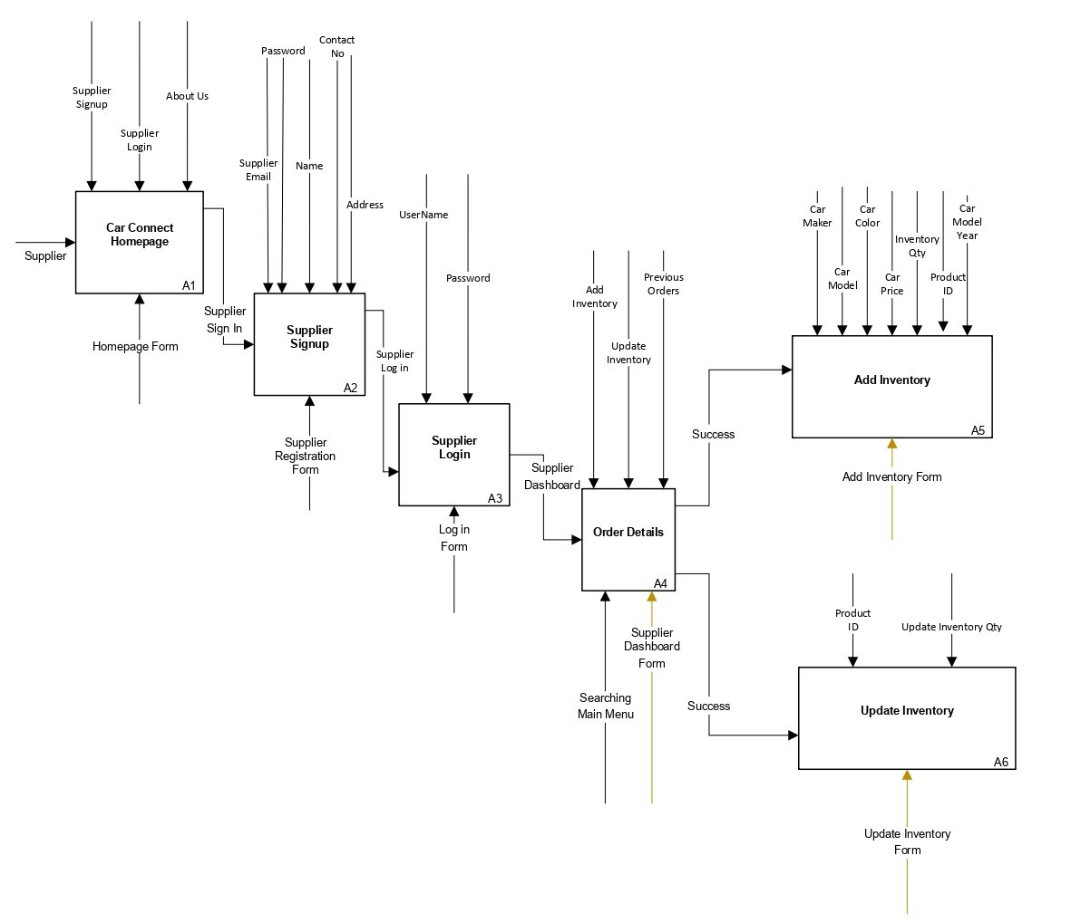
IDEF0 : SUPPLIER
CAR CONNECT

Slide 8


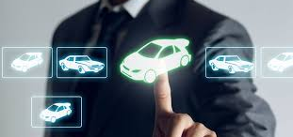
Integration of Machine Learning Algorithms
FUTURE ENHANCEMENTS
Enhance predictive inventory management, ensuring optimal stock levels.
Potential to serve as a pioneering model, adapting to the dynamic landscape of the automotive industry and fostering innovation in customer-supplier interactions.
Mobile App Deployment
Enable on-the-go transactions for both suppliers and customers.
Enhanced Data Analytics
Offer personalized recommendations based on user preferences.
Collaboration with Blockchain
Fortify security and transparency in transactions.
CAR CONNECT

Slide 9




KEY SUMMARY
Leveraging Dataset
CAR CONNECT
Supplier information, customer feedback, and real-time inventory
The third-party platform facilitates efficient automotive transactions
Project integrates IDEF0 modeling, IDEF1X, SQL, and Excel to connect car suppliers and customers seamlessly.
Represents a transformative vision for the tech-driven future of the automotive industry, emphasizing innovation and connectivity.
IDEF0 Streamlining
System functions & flow
Excel & SQL: Data Management & Analysis
Enables insightful data analysis & ensures secure data management
User-friendly Forms for Interaction
Enhance interaction experience

